Slide 1

SharePoint Framework - SPFx
mintesnot

Slide 2

What is SharePoint Site Customization?

Slide 3
SharePoint Connector in Power Automate
The SharePoint Connector is a built-in connector in Power Automate that enables communication between SharePoint and Power Automate.
Without the SharePoint connector, Power Automate cannot communicate with SharePoint.
Purpose of SharePoint Connector
It allows Power Automate to:
✅ Read SharePoint data ✅ Create records ✅ Update records ✅ Delete records ✅ Trigger workflows automatically ✅ Manage files and folders

Slide 4
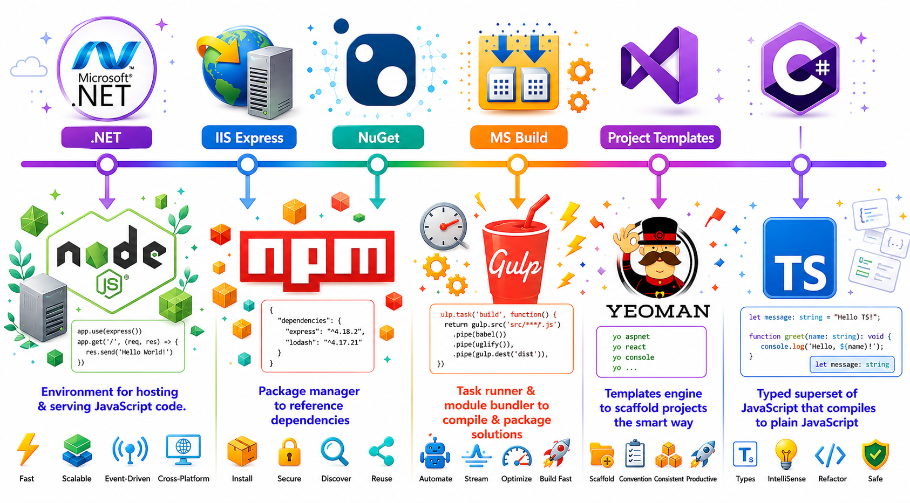
SPFx Development Toolchain

